Slide 1

Geometry
Unit 6, Lesson 2 Sequences of Transformations That Include Dilations Volume 1, pg. 290

Slide 2


Benchmarks
MA.912.GR.2.1
Given a preimage and image, describe the transformation and represent the transformation algebraically using coordinates.
MA.912.GR.2.3
Identify a sequence of transformations that will map a given figure onto itself or onto another congruent or similar figure.
volume 1, pg. 290

Slide 3
Integrated Mathematical Thinking and Reasoning Standards
MA.K12.MTR.2.1 Demonstrate understanding by representing problems in multiple ways.
MA.K12.MTR.3.1 Complete tasks with mathematical fluency.
MA.K12.MTR.4.1 Engage in discussions that reflect on the mathematical thinking of self and others.
MA.K12.MTR.5.1 Use patterns and structure to help understand and connect mathematical concepts.
volume 1, pg. 290

Slide 4

Learning Targets
I can describe a sequence of transformations that includes a dilation.
I can represent a sequence of transformations using coordinate notation with algebraic descriptors.
volume 1, pg. 290

Slide 5

Warm-Up
volume 1, pg. 291

Slide 6
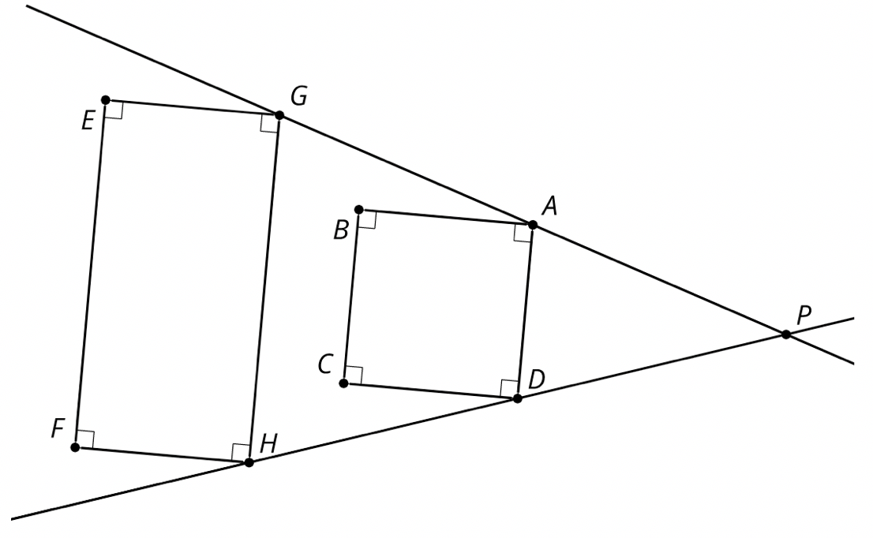
6.2.1 Warm-Up: Dilation Miscalculation
Cassandra tried to determine if the diagram shown represents a dilation.
$EGHF$, $BADC$, $\overset{⃡}{PG}$ and $\overset{⃡}{PH}$are shown.
volume 1, pg. 291

Slide 7

Cassandra listed four characteristics of dilations:
Of the characteristics Cassandra listed, which are not true for $EGHF$ and $BADC$?
Explain why the diagram shows that the dilation does not have these characteristics. If necessary, use the diagram to draw.
Characteristic | Yes/No
Corresponding angle measures are equal | Yes
Corresponding sides are parallel | Yes
Corresponding vertices are collinear with the point of dilation | Yes
Orientation of the shapes are the same | Yes
volume 1, pg. 291

Slide 8

Guided Instruction
volume 1, pg. 292

Slide 9
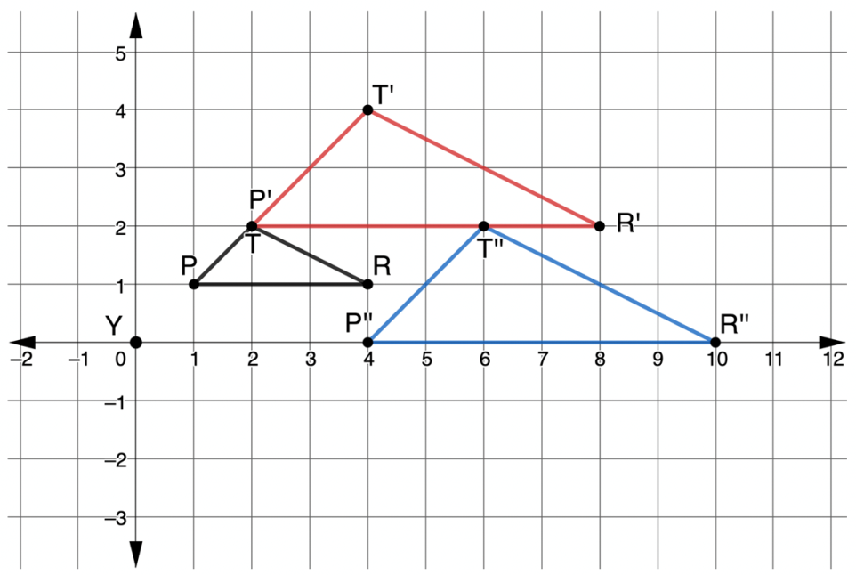
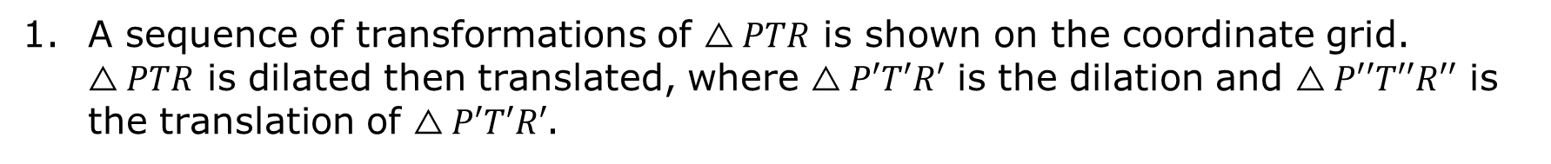
6.2.2 Guided Instruction: Sequence of Transformations
A sequence of transformations of $△PTR$ is shown on the coordinate grid. $△PTR$ is dilated then translated, where $△P′T′R′$ is the dilation and $△P′′T′′R′′$ is the translation of $△P′T′R′$.
volume 1, pg. 292

Slide 10

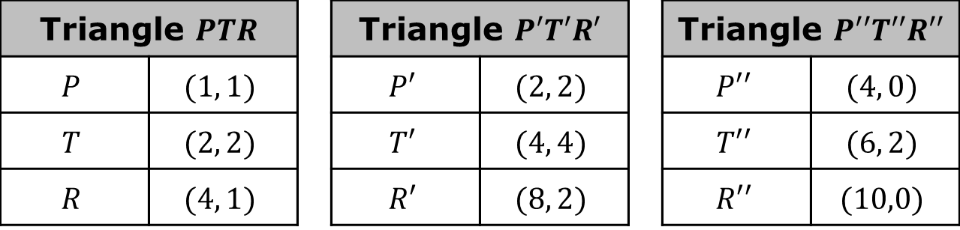
Complete the description.
$△PTR$ was dilated using a scale factor of _____ centered at the origin. The resulting polygon, $△P′T′R′$, was translated ______________________ to create $△P′′T′′R′′$.
Triangle $PTR$ |  |  | Triangle $P′T′R′$ |  |  | Triangle $P′′T′′R′′$
$$P$$ | $$(1, 1)$$ |  | $$P′$$ | $$(2, 2)$$ |  | $$P′′$$ | $$(4, 0)$$
$$T$$ | $$(2, 2)$$ |  | $$T′$$ | $$(4, 4)$$ |  | $$T′′$$ | $$(6, 2)$$
$$R$$ | $$(4, 1)$$ |  | $$R′$$ | $$(8, 2)$$ |  | $$R′′$$ | $$(10,0)$$
volume 1, pg. 292

Slide 11
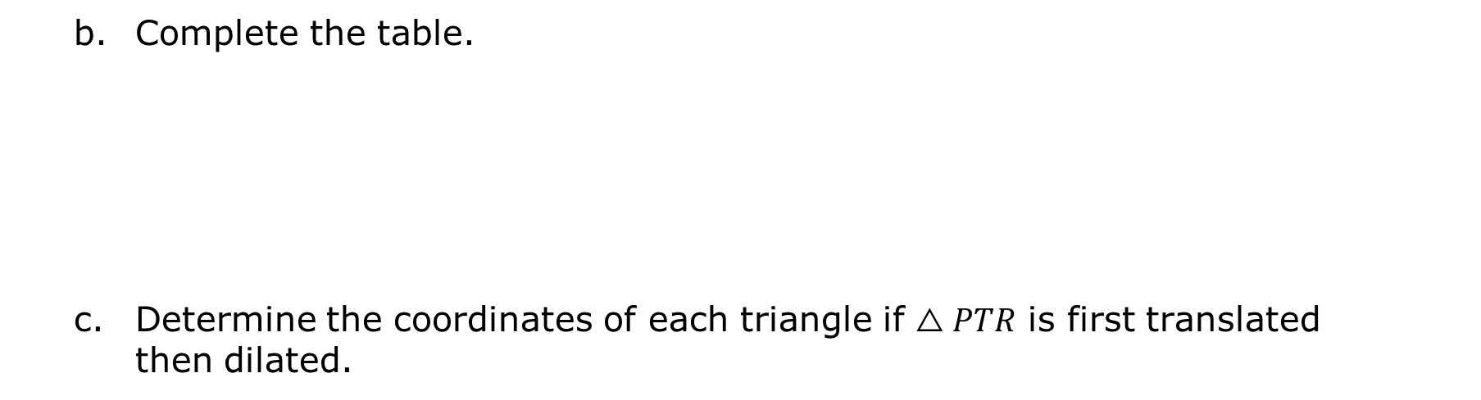
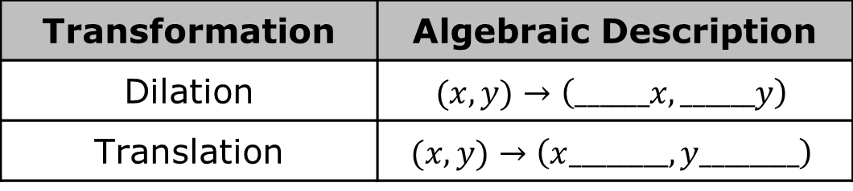
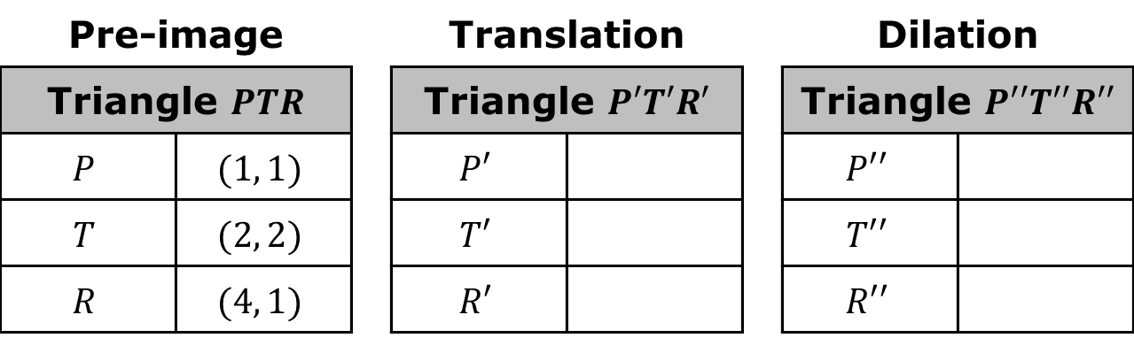
Complete the table.
Determine the coordinates of each triangle if $△PTR$ is first translated then dilated.
Transformation | Algebraic Description
Dilation | $$(x, y)→\left(______x, ______y\right)$$
Translation | $$(x, y)→\left(x________, y________\right)$$
Pre-image |  |  | Translation |  |  | Dilation
Triangle $PTR$ |  |  | Triangle $P′T′R′$ |  |  | Triangle $P′′T′′R′′$
$$P$$ | $$(1, 1)$$ |  | $$P′$$ |  |  | $$P′′$$
$$T$$ | $$(2, 2)$$ |  | $$T′$$ |  |  | $$T′′$$
$$R$$ | $$(4, 1)$$ |  | $$R′$$ |  |  | $$R′′$$
volume 1, pg. 292

Slide 12
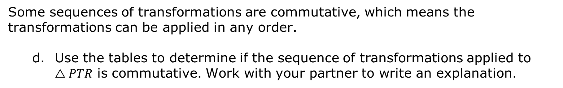
Some sequences of transformations are commutative, which means the transformations can be applied in any order.
Use the tables to determine if the sequence of transformations applied to $△PTR$ is commutative. Work with your partner to write an explanation.
volume 1, pg. 292

Slide 13
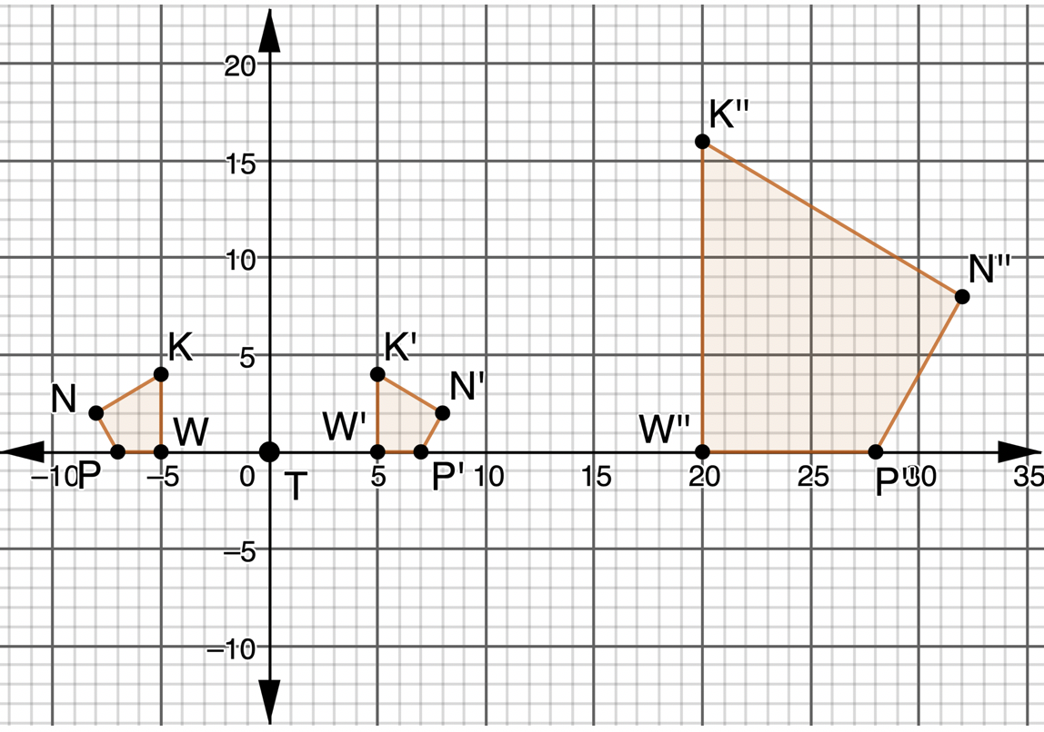
2. $KWPN$, $K′W′P′N′$, and $K′′W′′P′′N′′$ are shown on the coordinate grid.
volume 1, pg. 293

Slide 14
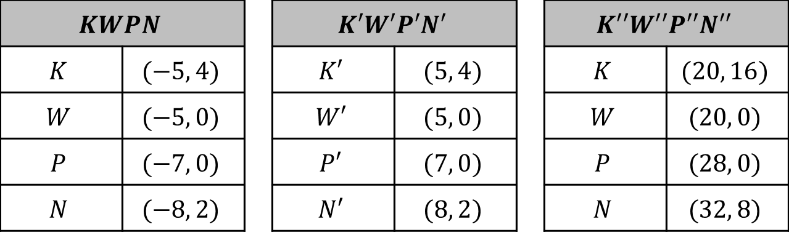
Discuss with your partner the first transformation that occurred. Describe how you determined the first transformation.
Determine the scale factor in the second transformation.
$$KWPN$$ |  |  | $$K′W′P′N′$$ |  |  | $$K′′W′′P′′N′′$$
$$K$$ | $$(−5, 4)$$ |  | $$K′$$ | $$(5, 4)$$ |  | $$K$$ | $$(20, 16)$$
$$W$$ | $$(−5, 0)$$ |  | $$W′$$ | $$(5, 0)$$ |  | $$W$$ | $$(20, 0)$$
$$P$$ | $$(−7, 0)$$ |  | $$P′$$ | $$(7, 0)$$ |  | $$P$$ | $$(28, 0)$$
$$N$$ | $$(−8, 2)$$ |  | $$N′$$ | $$(8, 2)$$ |  | $$N$$ | $$(32, 8)$$
volume 1, pg. 293

Slide 15
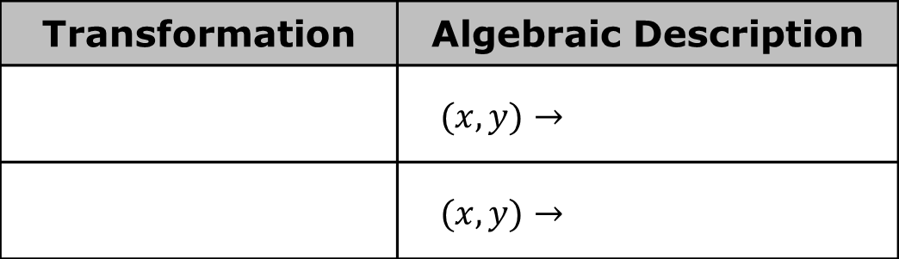
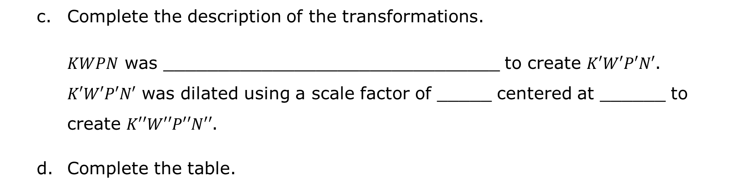
Complete the description of the transformations.
$KWPN$ was _______________________________ to create $K′W′P′N′$. $K′W′P′N′$ was dilated using a scale factor of _____ centered at ______ to create $K′′W′′P′′N′′$.
Complete the table.
Transformation | Algebraic Description
 | $$(x, y)→$$
 | $$(x, y)→$$
volume 1, pg. 293

Slide 16
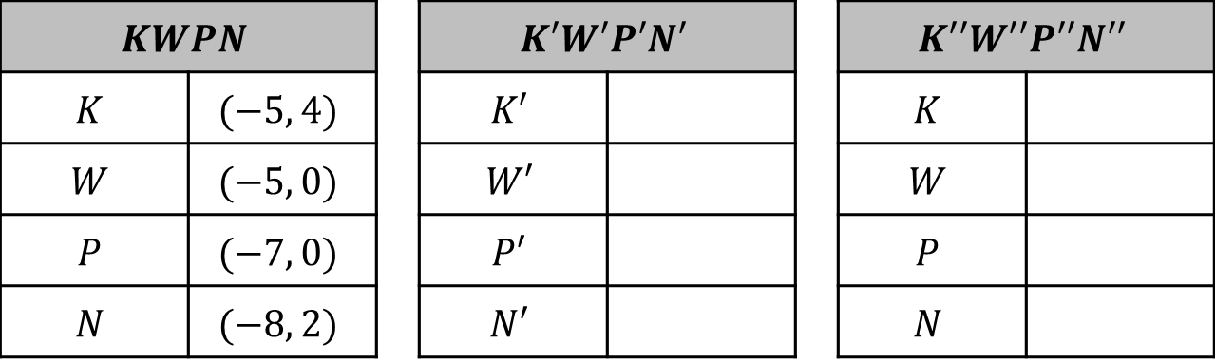
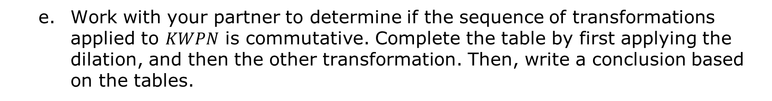
Work with your partner to determine if the sequence of transformations applied to $KWPN$ is commutative. Complete the table by first applying the dilation, and then the other transformation. Then, write a conclusion based on the tables.
$$KWPN$$ |  |  | $$K′W′P′N′$$ |  |  | $$K′′W′′P′′N′′$$
$$K$$ | $$(−5, 4)$$ |  | $$K′$$ |  |  | $$K$$
$$W$$ | $$(−5, 0)$$ |  | $$W′$$ |  |  | $$W$$
$$P$$ | $$(−7, 0)$$ |  | $$P′$$ |  |  | $$P$$
$$N$$ | $$(−8, 2)$$ |  | $$N′$$ |  |  | $$N$$
volume 1, pg. 293

Slide 17

Guided Practice
volume 1, pg. 294

Slide 18

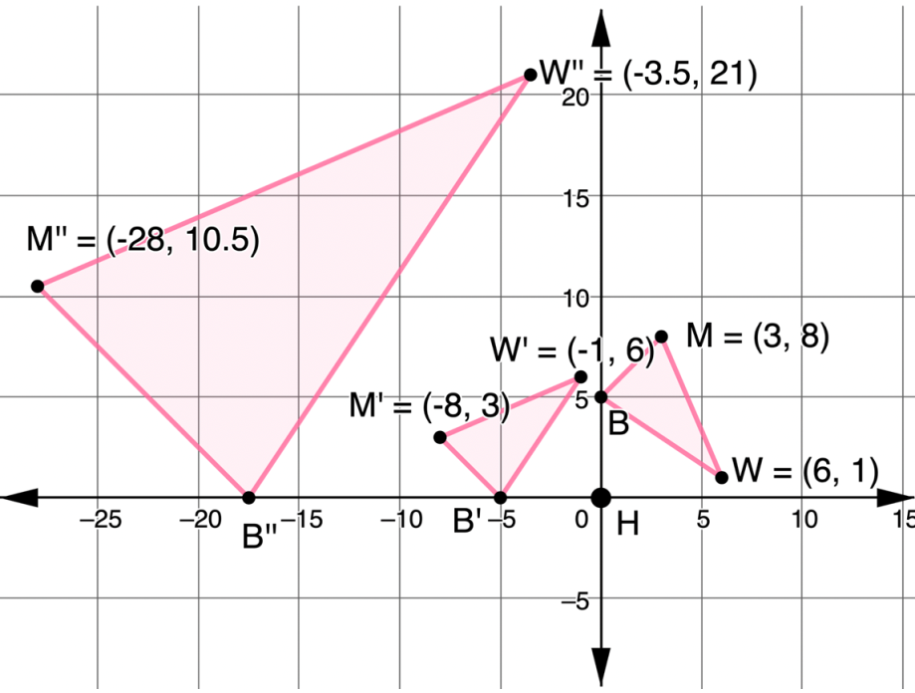
6.2.3 Guided Practice: Mapping a Dilation
A sequence of transformations of $△MWB$ is shown on the coordinate grid.
volume 1, pg. 294

Slide 19
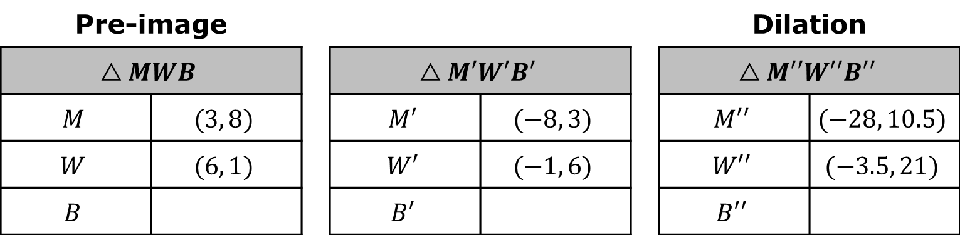

Complete the table of values for each triangle.
Complete the table.
Pre-image |  |  |  |  |  | Dilation
$$△MWB$$ |  |  | $$△M′W′B′$$ |  |  | $$△M′′W′′B′′$$
$$M$$ | $$(3, 8)$$ |  | $$M′$$ | $$(−8, 3)$$ |  | $$M′′$$ | $$(−28, 10.5)$$
$$W$$ | $$(6, 1)$$ |  | $$W′$$ | $$(−1, 6)$$ |  | $$W′′$$ | $$(−3.5, 21)$$
$$B$$ |  |  | $$B′$$ |  |  | $$B′′$$
Transformation | Algebraic Description
 | $$(x, y)→$$
 | $$(x, y)→$$
volume 1, pg. 294

Slide 20

Your Turn
volume 1, pg. 294

Slide 21
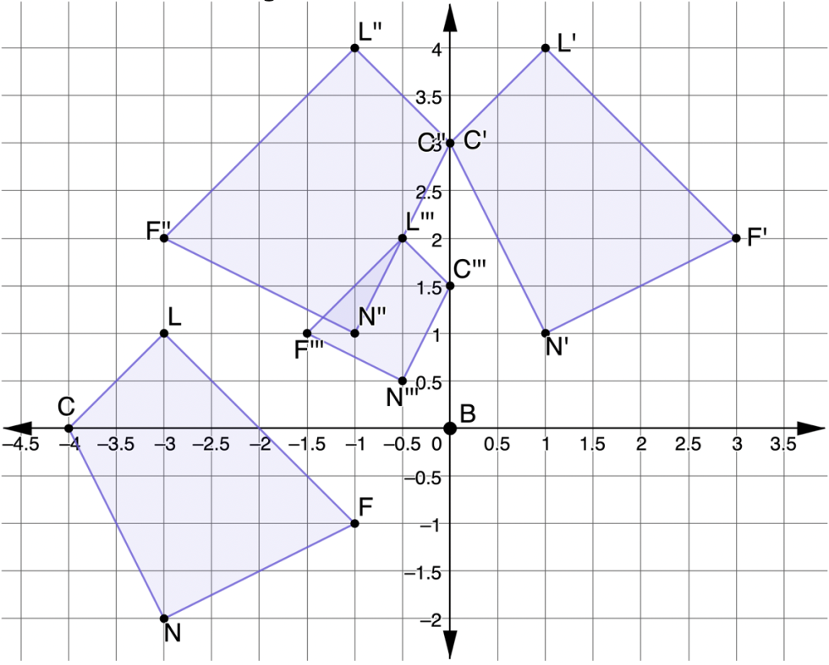
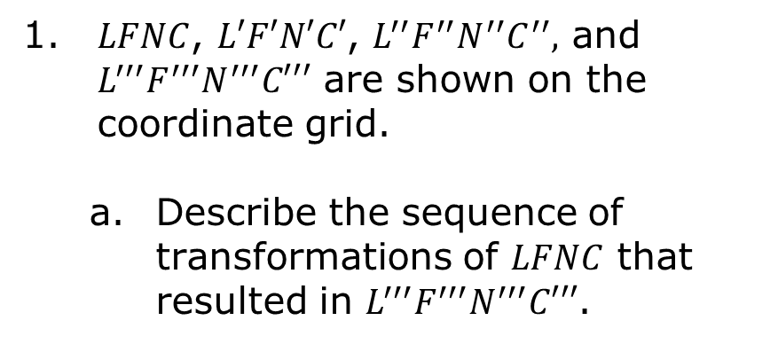
6.2.4 Your Turn!
1. $LFNC$, $L′F′N′C′$, $L^{′′}F^{′′}N^{′′}C^{′′},$ and $L^{′′′}F^{′′′}N^{′′′}C′′′$ are shown on the coordinate grid.
Describe the sequence of transformations of $LFNC$ that resulted in $L^{′′′}F^{′′′}N^{′′′}C′′′$.
volume 1, pg. 294

Slide 22
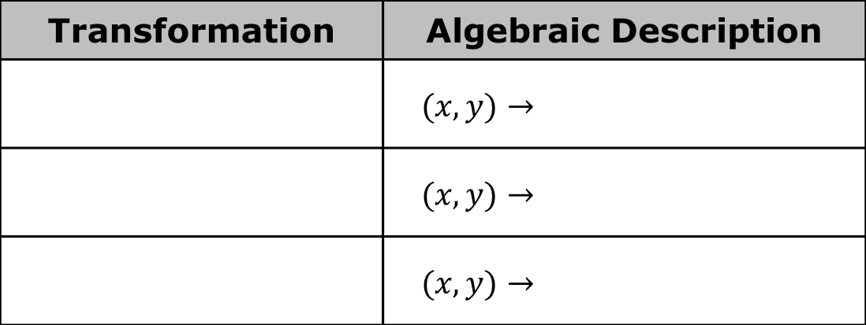
Write the algebraic descriptions of the sequence of transformations.
Transformation | Algebraic Description
 | $$(x, y)→$$
 | $$(x, y)→$$
 | $$(x, y)→$$
volume 1, pg. 295

Slide 23

Wrap-Up
volume 1, pg. 295

Slide 24
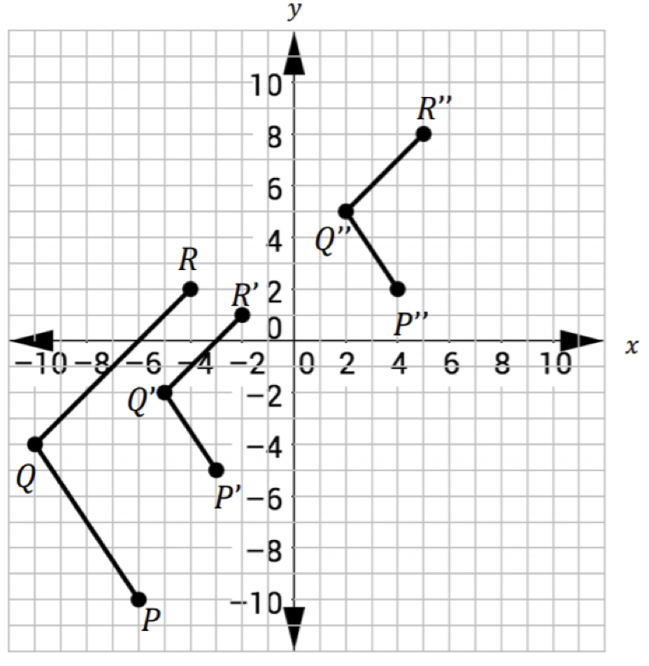
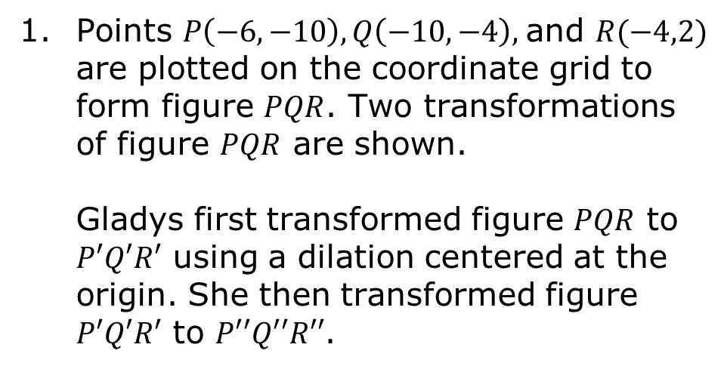
6.2.5 Wrap-Up: Ticket Out the Door
Points $P\left(−6,−10\right), Q\left(−10,−4\right),$and $R(−4,2)$ are plotted on the coordinate grid to form figure $PQR$. Two transformations of figure $PQR$ are shown.
Gladys first transformed figure $PQR$ to $P′Q′R′$ using a dilation centered at the origin. She then transformed figure $P′Q′R′$ to $P′′Q′′R′′$.
volume 1, pg. 295

Slide 25
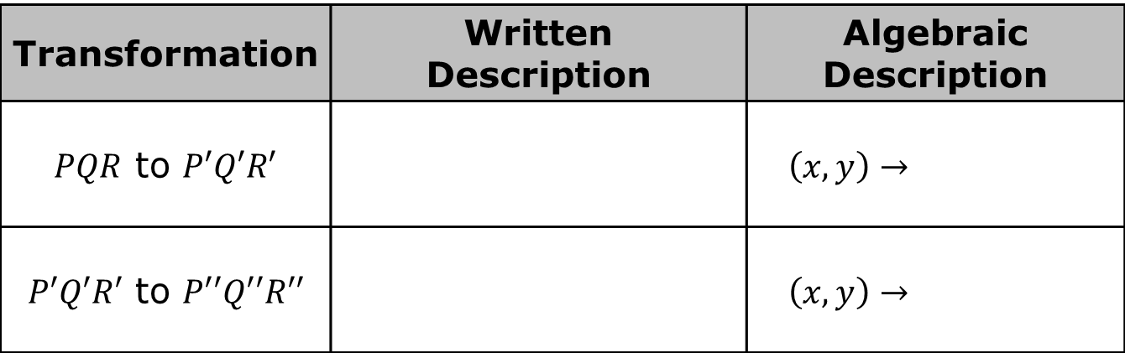
Complete the table.
Transformation | Written Description | Algebraic Description
$PQR$ to $P′Q′R′$ |  | $$\left(x, y\right)→$$
$P′Q′R′$ to $P′′Q′′R′′$ |  | $$\left(x, y\right)→$$
volume 1, pg. 295

